Slide 1



CEEGY
Insurance Loss Analytics
By: Group 25
Cathy Fang, Gina Liao,
Eve Miao, Yini Li, Yuxuan Li

Slide 2
"Elon Musk: “So... you're applying for the Tesla Summer Data Science Internship.
I heard you're working on insurance... loss prediction? Yeah Cool. How'd you get started with it? Like, can you walk me through it...?’”

Slide 3


01
LC & HALC & CS Calculation – Targets defined by project; reflect core business risk.
02
Date Conversion – Transformed into driver age, license age, vehicle age, policy duration — critical rating factors.
Data Processing
03
One-Hot Encoding – Risk Type (Motorbikes vs. passenger), Channel (Agent vs. broker), and Energy Source (Diesel vs petrol)
04
Null Handling – Diesel, petrol, and “other” fuel types affect operating cost & usage patterns.
Notes:
To ensure accurate prediction of LC, HALC and CS, which directly impact how insurers set fair, profitable premiums and avoid adverse selection​
Risk Type One-hot Encoding – Motorbikes vs. passenger cars reflect drastically different loss profiles.
Channel One-hot Encoding – Agent vs. broker may influence policy quality and fraud risk.

Slide 4
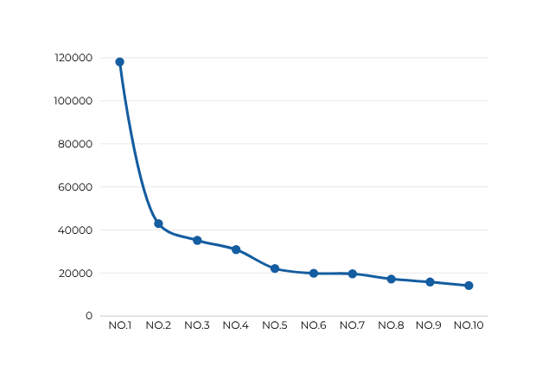
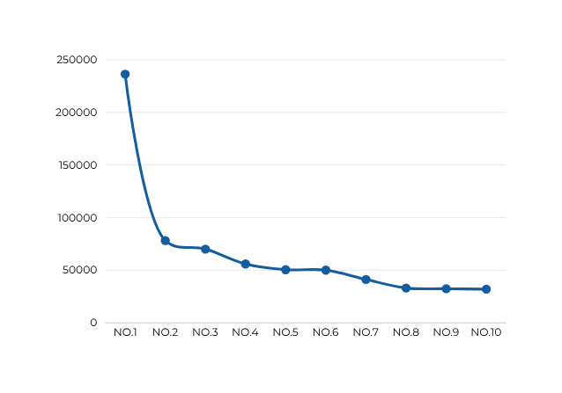
Outliers
Number of 0 in 'LC' : 33300
Number of 0 in 'HALC' : 33317
Top 10 numbers in 'LC'
Top 10 numbers in 'HALC'
Min: 4 Max: 118,142
Min: 3 Max: 236,285
To mitigate the influence of rare extreme claim values and maintain model stability to to avoid skewed model learning, we capped LC at $20,000 and HALC at $30,000
Notes:
“To align our model with real-world insurance practices, we applied caps of $20,000 for LC and $30,000 for HALC. In personal auto insurance, claims exceeding these amounts are rare and often managed via reinsurance or special coverage limits. This cap helps stabilize model training, limit distortion from extreme outliers, and reflect how insurers manage catastrophic exposure in practice.”
To mitigate the influence of rare extreme claim values and maintain model stability to to avoid skewed model learning, we capped LC at $50,000 and HALC at $80,000
Benefit:
1.Transparent to business partners: Business teams or auditors often prefer hard rules over statistical percentiles.
2.Customizable: You can align the cap with reinsurance thresholds, policy limits, or historical claim ceilings.
This method is called hard thresholding, and it’s especially useful when:
You have domain knowledge (e.g., claims over 50K are rare and unusually severe).
You want a clear, interpretable rule for stakeholders.
You’ve already seen that only a few rows exceed 50K (like your 118,142 case).

Slide 5
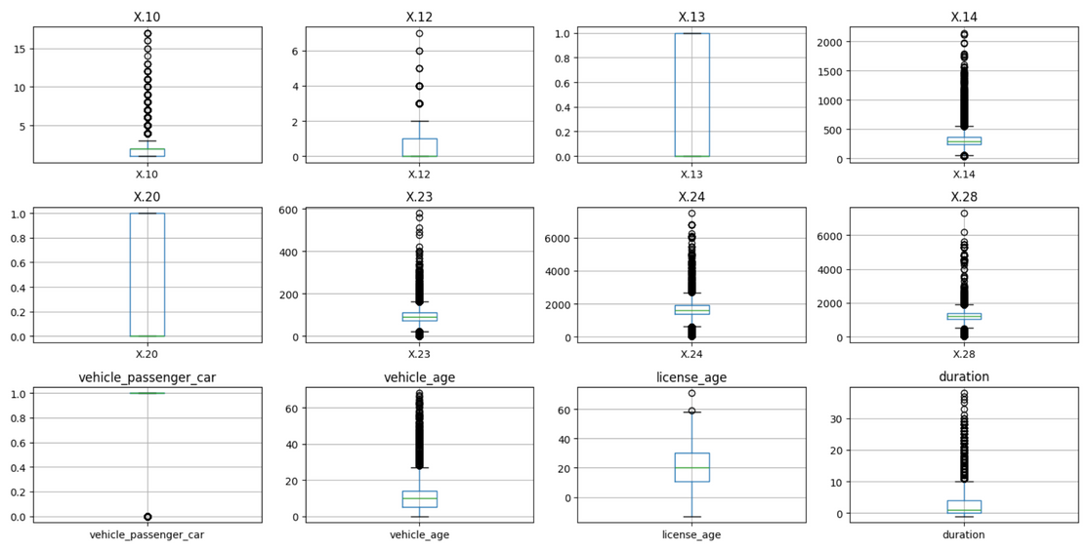
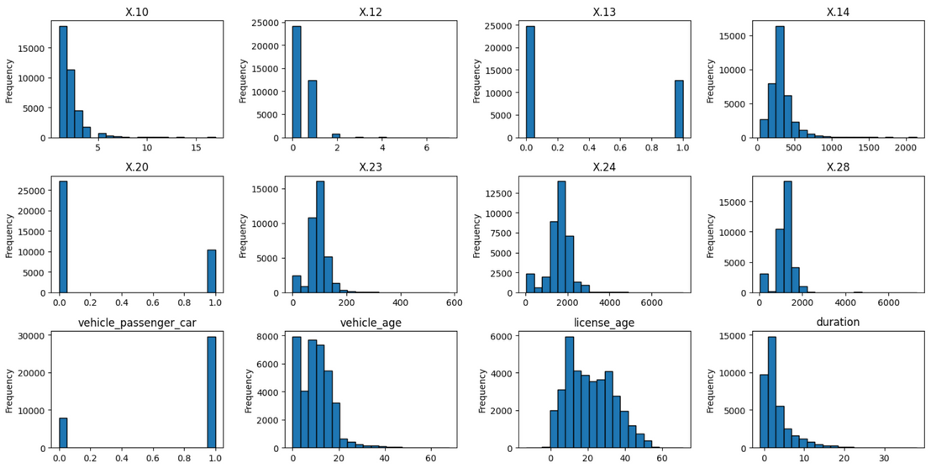
Why We Chose Not to Drop More Outliers
  Statistical Reason: Removing or transforming these features would risk losing valuable predictive signals.
  Business Insight: In insurance, a small number of policyholders generate the majority of claims — this skewed pattern is core to pricing and risk assessment, not noise to discard.
Notes:
“We noticed strong right skewness in several features, but instead of removing them, we chose to keep them because this pattern mirrors how insurance risk actually works — many customers have low exposure, but a few have very high claims or policy durations. That skew isn’t a modeling error; it’s a valuable risk signal.”

Slide 6
"Okay. Now the fun part. You've got messy insurance data and a bunch of zeros. Let me guess — you just threw XGBoost at it and hoped for the best?"

Slide 7
Model Comparison and Evaluation Strategy
  Variable Selection: L1 Regularization & Shap
    Behavioral & Loyalty Indicators：
      Cancellations
      Payment pattern
      Policy duration
      License age
    Vehicle-Related Risk Factors:
      Power, CC, Weight
      New vs old cars
      Type of car (1-hot)
    Pricing / Policy Exposure
      Premium paid
      Max policies held
      Urban vs rural
  Tune hyperparameters: K-fold
Regression Model | LC MSE | LC RMSE | HALC MSE | HALC RMSE
Tweedie GLM | 197155.60 | 444.02 | 682975.21 | 826.42
Neural Network | 196525.88 | 443.31 | 681166.44 | 825.33
Light GBM | 198675.23 | 445.73 | 689198.83 | 830.18
XGBoost | 198007.20 | 444.98 | 687738.49 | 829.30
Weighted Ensemble | 195098.89 | 441.70 | 679668.336 | 824.42
Notes:
We didn’t just throw XGBoost at it — we started with the basics: good old feature selection. Because if your inputs are messy, no model's gonna save you.
After basically processing, I used Lasso to refine my features set. It helped me drop noisy or redundant features, and retain only the ones that truly mattered. Lasso is more appropriate for Tweedie to reduces multicollinearity. Shap would be strongly preferred when using Random Forest or XGBoost. In the end, I narrowed it down to 12 features, including behavioral patterns, vehicle risks, and pricing info.
Once I had my features locked in, I tuned hyperparameters using k-fold and moved on to model comparison. I tried SVR, but it was painfully slow— definitely not scalable. Random Forest Regression and ElasticNet also underperformed. The RMSEs are pretty high.
Alright — so that’s how I picked my features and ruled out a few not-so-great models. Now, I am going to tell you what actually worked the best.

Slide 8



Model Ensembling
Why Ensembling?
Final Prediction
  Each model has own strength & weakness
  Reduces overfitting and improves robustness
50% × Tweedie GLM
+
30% × Neural Network
+
20% × XGBoost
+
0% × Light GBM
Business Application
  Reduces prediction risk by smoothing out individual model errors
  More stable when facing data shifts or market changes
  Easy to update, low cost

Slide 9

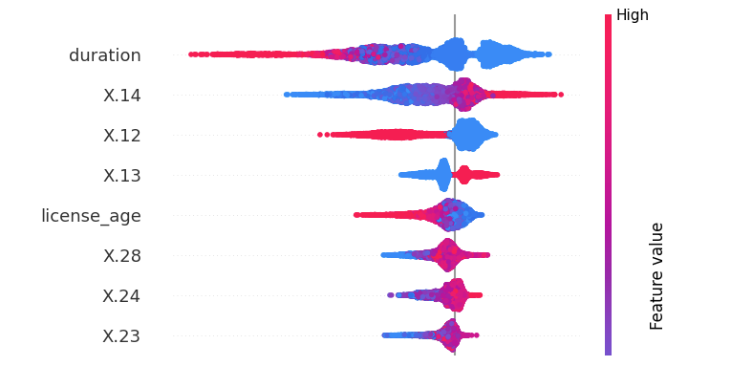



SHAP
What Drives Loss Cost?
Policy Duration
Net Premium
Policy Duration
# of Cancelled Policies
Premium Amount
Payment Frequency
License Age
Vehicle Weight
Cylinder Capacity
Cancelled Policies
Payment Frequency
Vehicle Power

Slide 10
"So now you're trying to guess whether someone's gonna file a claim. Basically, you're predicting human chaos. Fun. What's your approach — magic? Or did you bring actual features this time?"

Slide 11
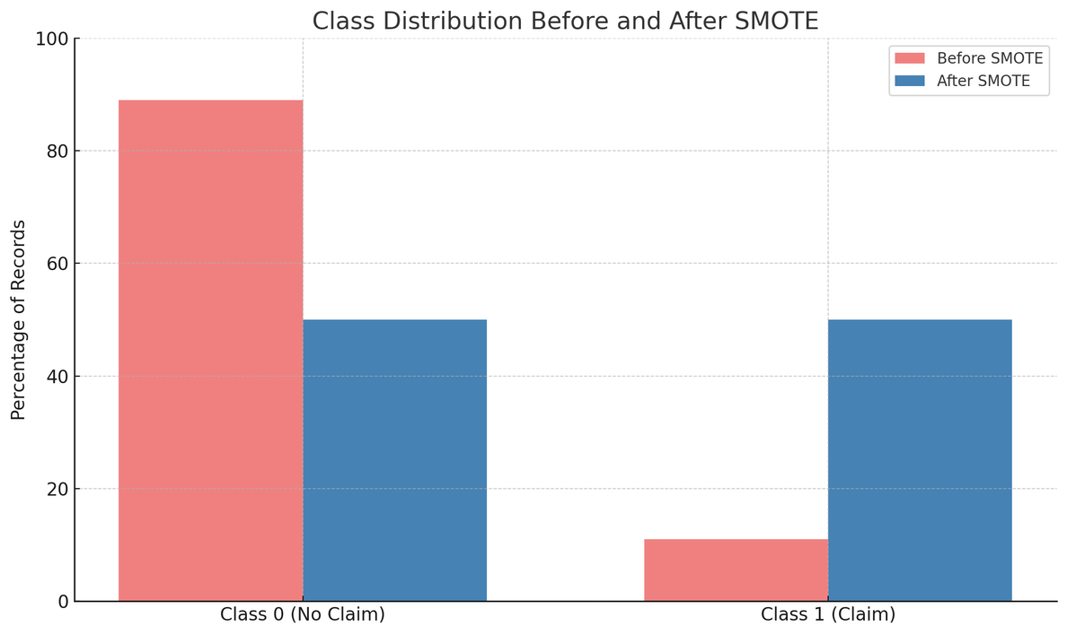
Dealing with Class Imbalance
The Challeange:
  Claim Status (CS) highly imbalanced
    Class 0 (no claim): ~89%
    Class 1 (claim): ~11%
  Most models default to predicting “no claim” → misleading accuracy
Why It Matters:
  Business risk: Missing real claimants leads to underpricing
  Catching claims = more accurate pricing + portfolio protection
Our Solution: SMOTE
  Balances the training data → synthetic examples for the minority class (CS = 1)
  Applied only to training data
  Helps models learn class 1 patterns without overfitting

Slide 12
Model Comparison and Evaluation Strategy
Key Metrics (Business-Aligned)
  Recall (Class 1) → % of actual claimants captured (business priority)
  ROC-AUC → Overall ability to rank claimants
  F1-Score (Class 1) → Trade-off between catching claims and avoiding false alarms
  Accuracy → Misleading in imbalanced datasets; not prioritized
Model | ROC-AUC | Recall (1) | F1 (1) | Accuracy
Random Forest | 0.7356 | 0.03 | 0.06 | 0.89
Gradient Boosting | 0.7347 | 0.01 | 0.01 | 0.89
LightGBM | 0.7400 | 0.00 | 0.00 | 0.89
XGBoost | 0.7371 | 0.69 | 0.31 | 0.66

Slide 13
XGBoost
ROC-AUC | Precision | *Recall* | F1-Score | Accuracy
0.0.73717371 | 0.20 | 0.69 | 0.31 | 0.66
Recall
Ability to catch actual claims
  Low recall means missed claims which leads to underpriced premiums
  Better to flag a few non-claims than miss real claims
  Most effective at identifying high-risk policyholders
  Supports accurate risk pricing and reduces adverse selection

Slide 14
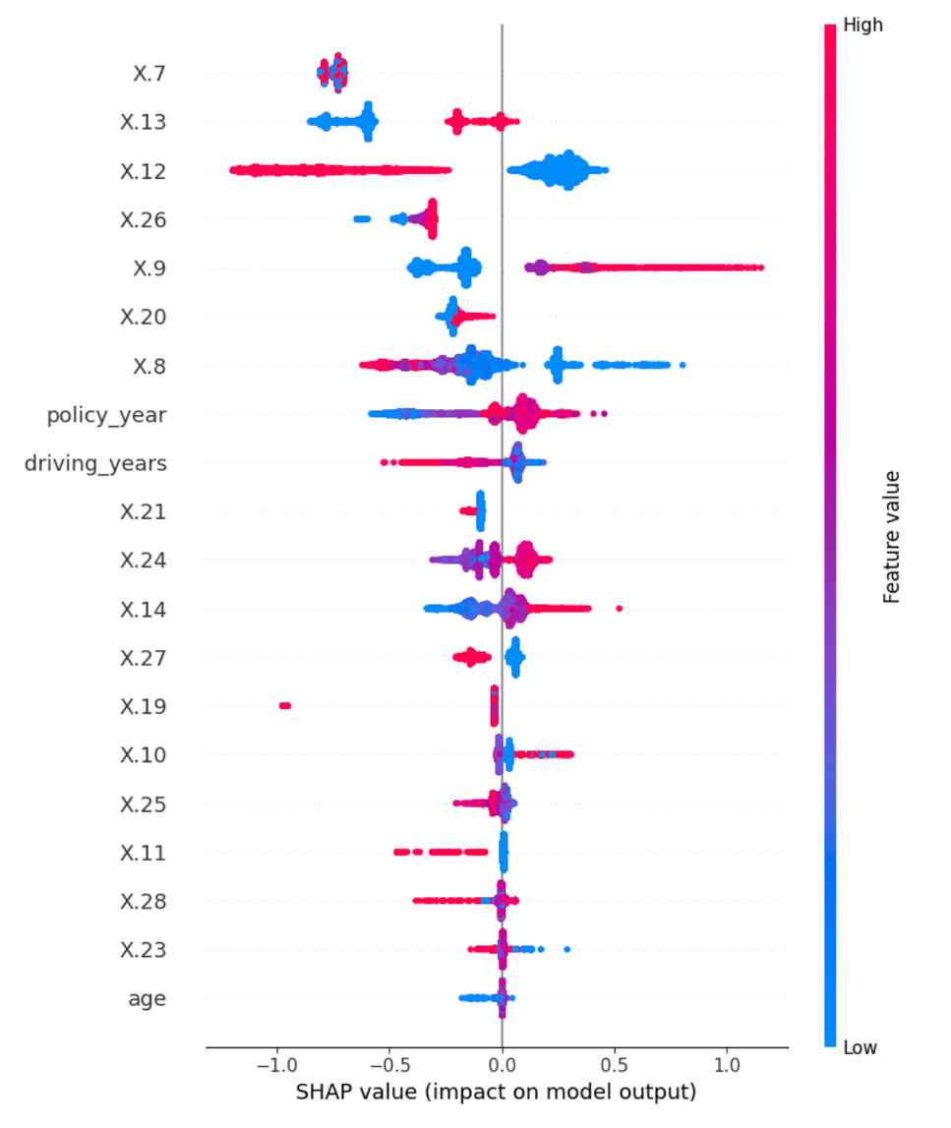

Purchase Channel
SHAP
Payment Frequency
# of Cancelled Policies
# of Car Doors
What Drives Claim Predictions?
# of Insurance Held
Area
Years with Entity
Policy Years
Driving Years
Single/Multiple Drivers
Purchase Channel
Payment Frequency
Cylinder Capacity
Net Premium
Energy Source
Vehicle Type
Max Policies In Force
Vehicle Market Value
Max Policies Held
Cancelled Policies
Experience & Duration
Vehicle Weight
Vehicle Power
Driver Age

Slide 15



Challenges & Limitation
Imbalanced Data
Temporal Data
Auto Insurance ONLY
Most policyholders don’t file claims, and loss amounts are often zero or extremely high. It is difficult for models to learn accurate patterns.
Dates like policy start, license issuance, and vehicle registration require thoughtful transformation into meaningful features (e.g., policy duration, driver age).
It's trained on auto-specific features and lacks relevant health, demographic, and lifestyle data critical for life insurance pricing.

Slide 16

FURTHER IMPROVEMENT
Segmenting the data by risk type (X.19) and building separate models
01 Different behavior
02 Better performance
03 Business alignment
Different vehicle types (motorbikes, vans, passenger cars, agri vehicles) have vastly different claim frequencies, severities, and costs. Modeling them together may blur the signals.
Separate models can better capture the unique patterns, relationships, and distributions for each risk type — leading to higher accuracy.
Insurers often treat different risk segments differently: pricing rules, fraud flags, underwriting policies, etc.
Notes:
Strategy:
Our dataset is heavily dominated by Passenger Cars (X.19 = 3), which account for approximately 79% of all policy records. In contrast, Vans make up about 12%, Motorbikes around 8%, and Agricultural Vehicles only 0.7% of the total.
Given this imbalance, building separate models for each risk type may not be the most efficient approach. While passenger cars have enough data to justify a dedicated model, the smaller groups — especially agricultural vehicles — may not have sufficient records to train accurate, stable models on their own.
✅ 1. Build a separate model for Passenger Cars (X.19 = 3)
You have plenty of data — this is your main group, and accuracy will matter most here.
You can tune it well with Tweedie or Neural Network, etc.
✅ 2. Combine Risk Types 1, 2, and 4 into one “Other” model
Combined: 3,039 + 4,586 + 251 = 7,876 (about 21%)
Risk type 4 (Agri) alone has only 251 rows → not enough to train a good model alone.
But grouping them together gives you a decent dataset for a general “non-passenger car” model.

Slide 17
"Not bad. You just might survive the Tesla internship. Unless you build a model that predicts Elon tweets — that's career suicide."

